Slide 1

EYFS vision at Westfield Infants School
“It is our responsibility as early childhood educators to plan an environment, and curriculum experiences, where every child can show us their successful selves:
where every child goes home at the end of the day talking about what they did and what they enjoyed – and not what they could not do and what made them upset.”
Julie Fisher 2024

Slide 2
How we learn in EYFS
Adult Led Learning
Child Initiated Learning
Adult Initiated Learning
- Controlled by the adult
- Plan, objective, activity and purpose all adult led.
- The original intention belongs to the adult.
- The children are left to learn independently and may take learning in a different direction.
Group work
Enhanced Provision
The objectives are theirs.
The purpose of the activity is theirs.
The process is theirs.
The evaluation of what is achieved is theirs.
Continuous Provision

Slide 3
Continuous Provision Layout
Our provision is designed to provide the best opportunities for interactions and learning.
Construction
Small World
Domestic Role Play
Writing Area
Creative
Painting
Maths Area
Water
Malleable

Slide 4
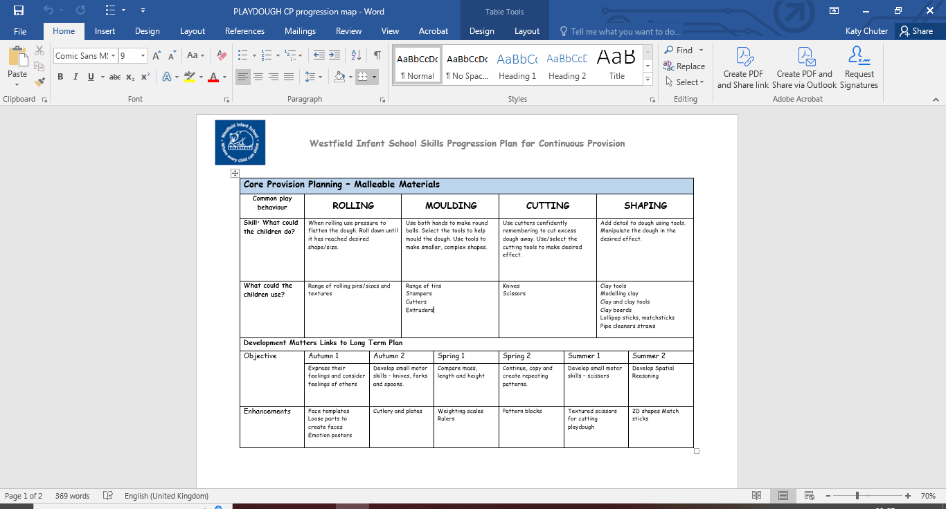
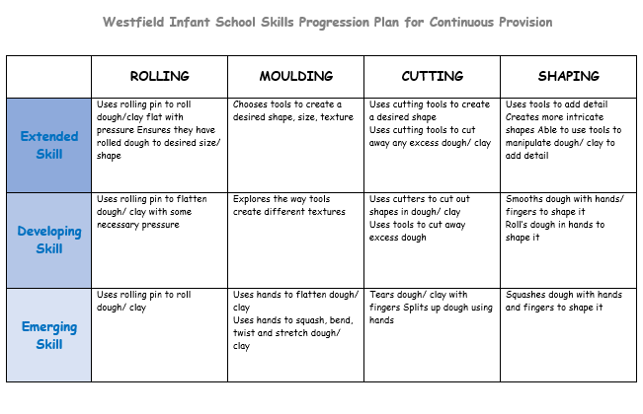
Progression of skills in Continuous Provision

Slide 5
What you should see in all areas.
Communication & Language development
Opportunities for interactions
Writing resources
Gross/Fine motor skills
Physical challenge
Maths resources
Writing

Slide 6
“For me, the curriculum is all that children learn in our settings.”
Julie Fisher 2024
It is key that, at Westfield Infants, we think of the whole child to provide a broad and balanced offer.

